Slide 1

NFL Offensive Stats: A Plotly Story
Group 4
Trey griffin David (Manny) Cook-Francis Grant Grossman Aakash Rahman David Debrowski Michael Peyser

Slide 2
The Theme
Since 2008, the NFL has seen a dramatic increase in the amount of offensive productive production, primarily in the area of passing yards. Our contention is that this offensive explosion in passing has led directly to the emergence of championship teams & has forever changed the way the game is played.

Slide 3
The Coding Approach

Slide 4
Data Merging Techniques

Slide 5
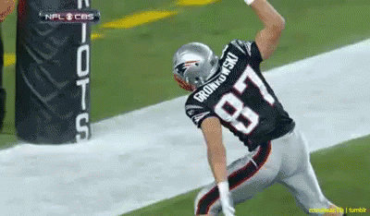
The Visuals
https://nflproject.herokuapp.com/plots
Through the use of the GreenSock Animation Platform (GSAP), we were able to animate our website with the power of JavaScript.

Slide 6

Conclusions - Statistics from 2002-2019 suggest a direct correlation between an increase in passing yards & the total number of touchdowns scored. - During that same time period, rushing yards have steadily decreased. - Total offensive yards from 2002-2019 have steadily increased, which indicates the passing game in the NFL has become much more prevalent over the years, based upon our data.
Notes:
1.) The statistics from 2002-2019 show that an increase in passing yards also led to additional success in offensive production with an increase in passing touchdowns over that same period.

Slide 7
Questions

